Slide 1







SOFT ROBOTICS WORKSHOP
Created by C. O. Braganza, University of Bristol

Slide 2

RICE PAPER SOFT ROBOTICS WORKSHOP
WHAT DO YOU IMAGINE WHEN YOU THINK OF A ROBOT?
WHAT DO YOU IMAGINE WHEN YOU THINK OF A ROBOT?

Slide 3
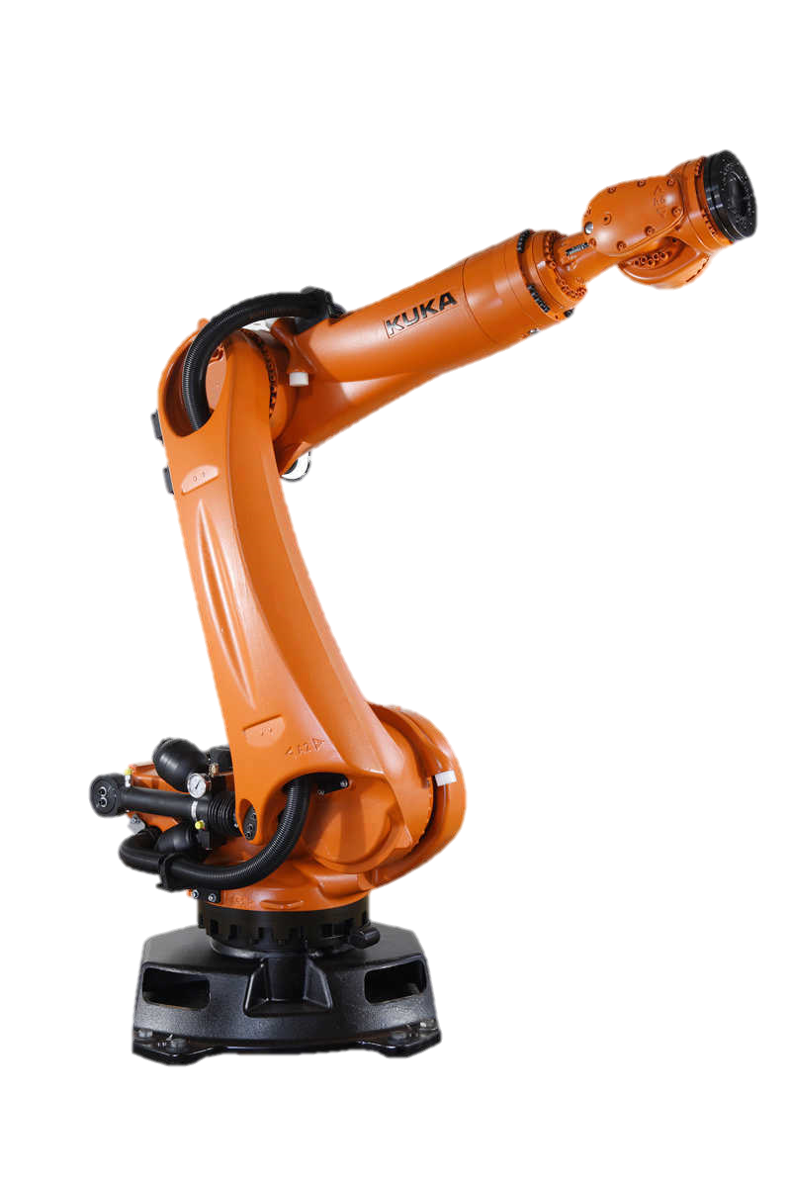

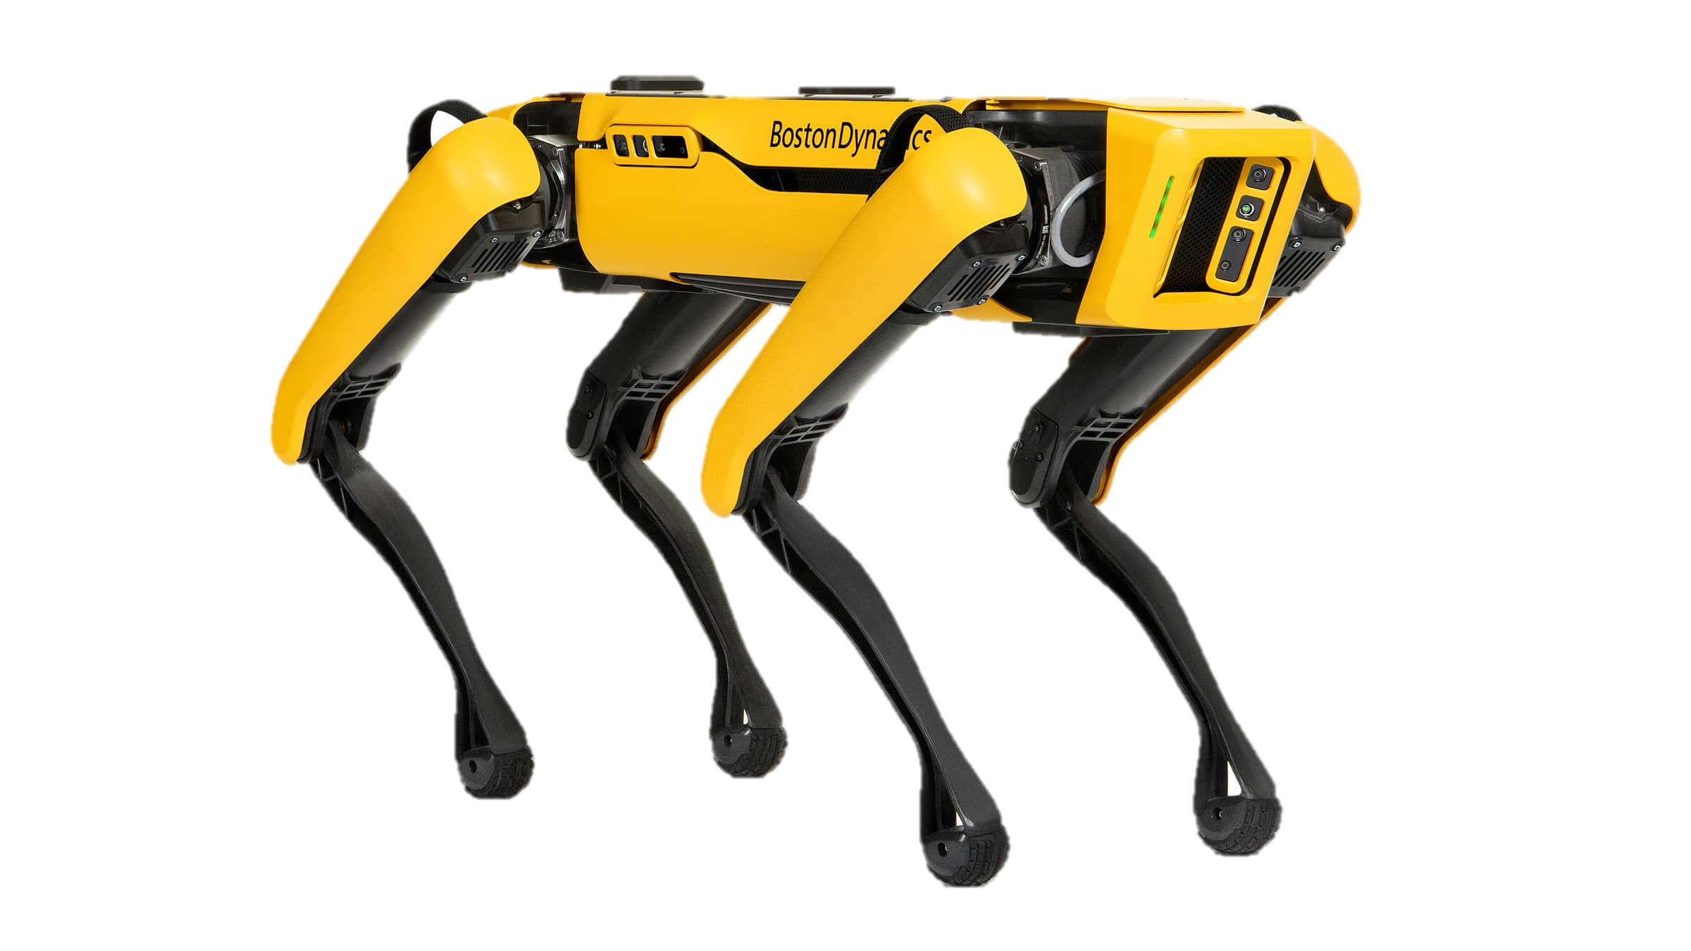
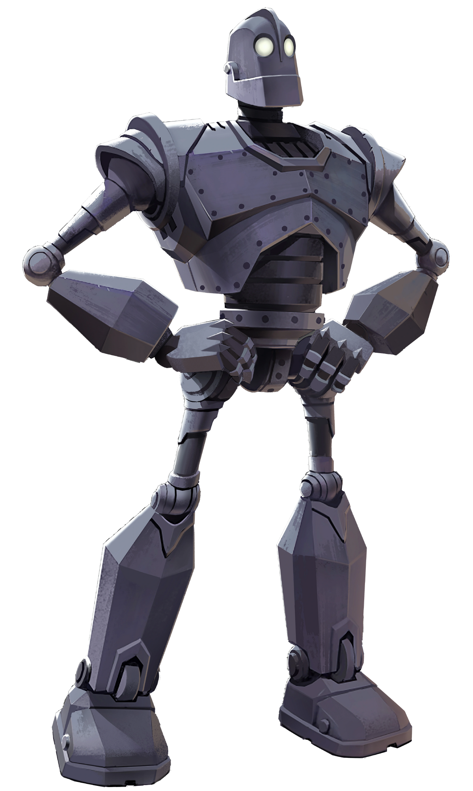
RICE PAPER SOFT ROBOTICS WORKSHOP
WHAT DO YOU IMAGINE WHEN YOU THINK OF A ROBOT?
WHAT MATERIALS DO YOU THINK ROBOTS ARE COMMONLY MADE OF?
AI GENERATED ROBOT
SPOT ROBOT BY BOSTON DYNAMICS
THE IRON GIANT (BOOK/MOVIE)
KUKA ROBOT ARM

Slide 4
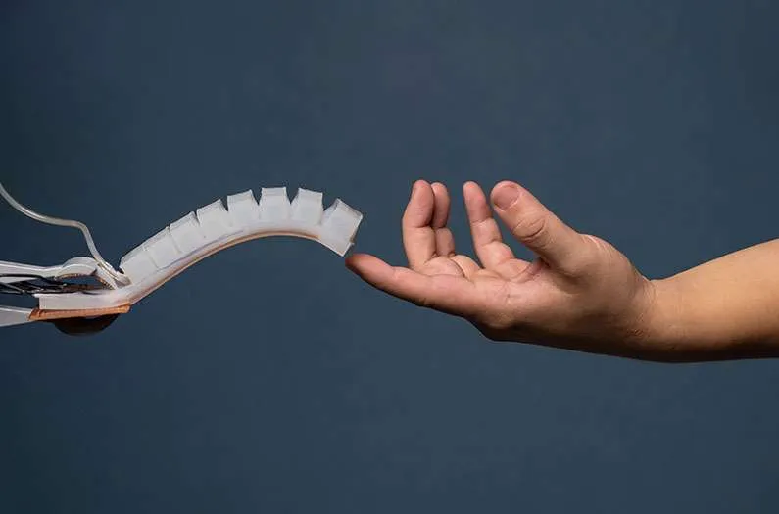
RICE PAPER SOFT ROBOTICS WORKSHOP
WHAT IS SOFT ROBOTICS?
Soft robotics is an area of robotics that uses flexible materials rather than rigid materials.
Notes:
Natural organisms are made of many types of materials that can have different behaviours! Like you and me.

Slide 5



RICE PAPER SOFT ROBOTICS WORKSHOP
WHY MIGHT A SOFT ROBOT BE USEFUL COMPARED TO A METAL ONE?
Soft Robots are safe to interact with humans!

Slide 6
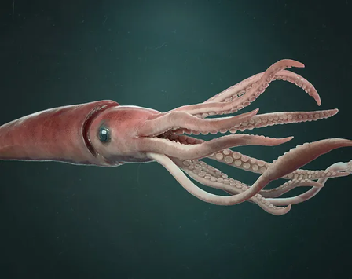
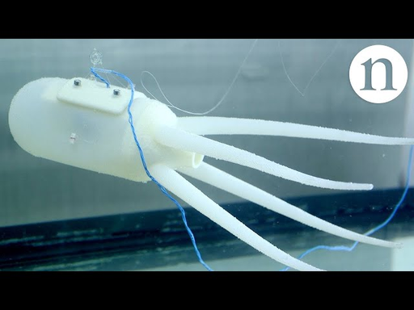
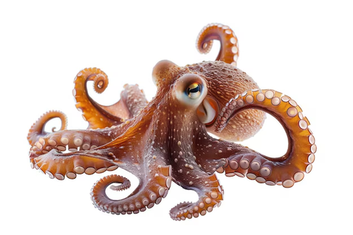
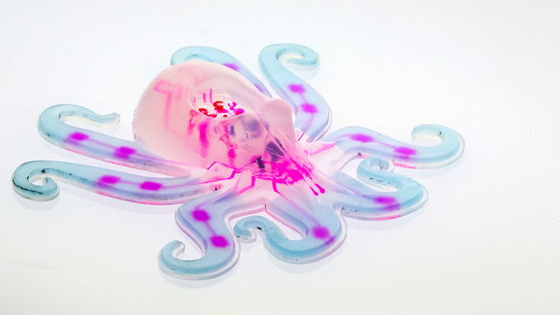

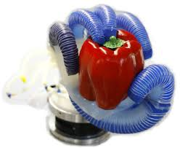
RICE PAPER SOFT ROBOTICS WORKSHOP
BIOMIMICRY & SOFT ROBOTS
LIVING ORGANISMS
SOFT ROBOTS

Slide 7



RICE PAPER SOFT ROBOTICS WORKSHOP
GRIPPERS!
1. HOVER THE SILICONE OVER THE OBJECT
2. INFLATE TO ACTIVE AND GRIP THE OBJECT

Slide 8
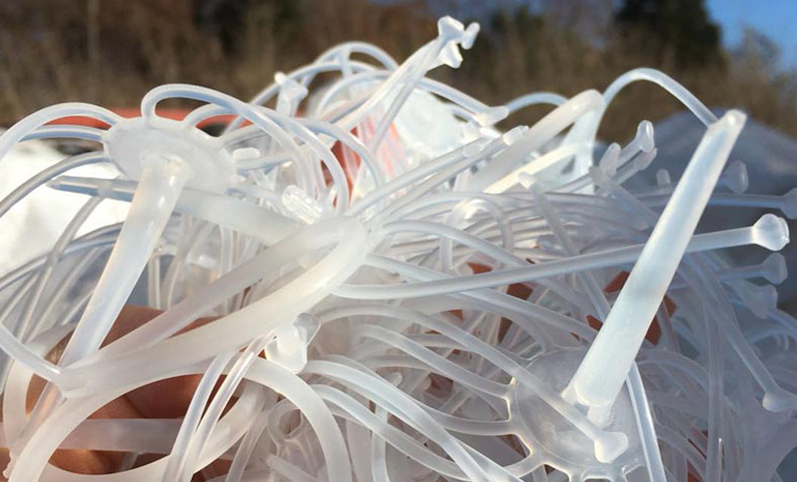
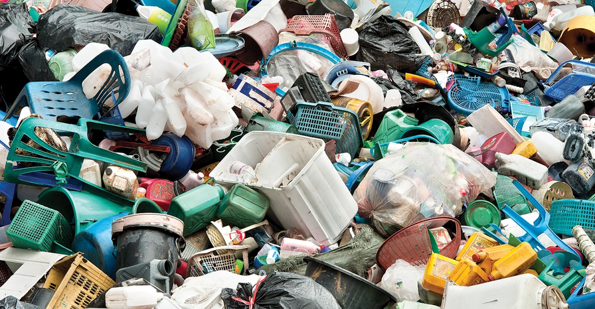
RICE PAPER SOFT ROBOTICS WORKSHOP
WHAT MIGHT AN ISSUE BE WITH USING SILICONE AS A MATERIAL TO MAKE ROBOTS?

Slide 9
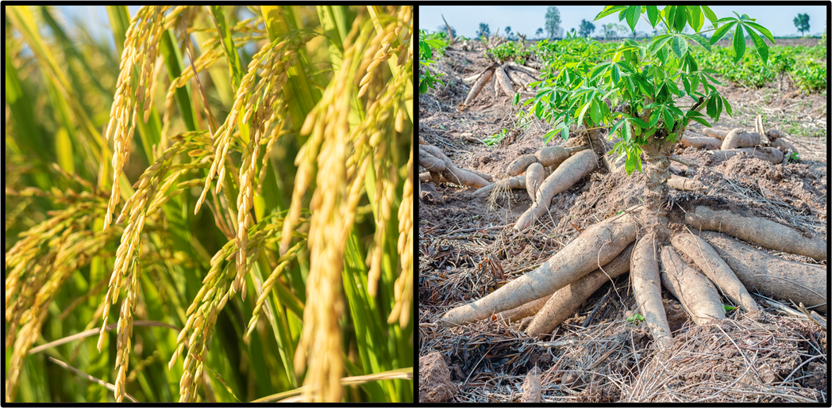

RICE PAPER SOFT ROBOTICS WORKSHOP
WHY RICE PAPER?
Rice paper is made from renewable plants like rice and cassava root so is sustainable and low cost!

Slide 10
RICE PAPER SOFT ROBOTICS WORKSHOP
DEMO!

Slide 11
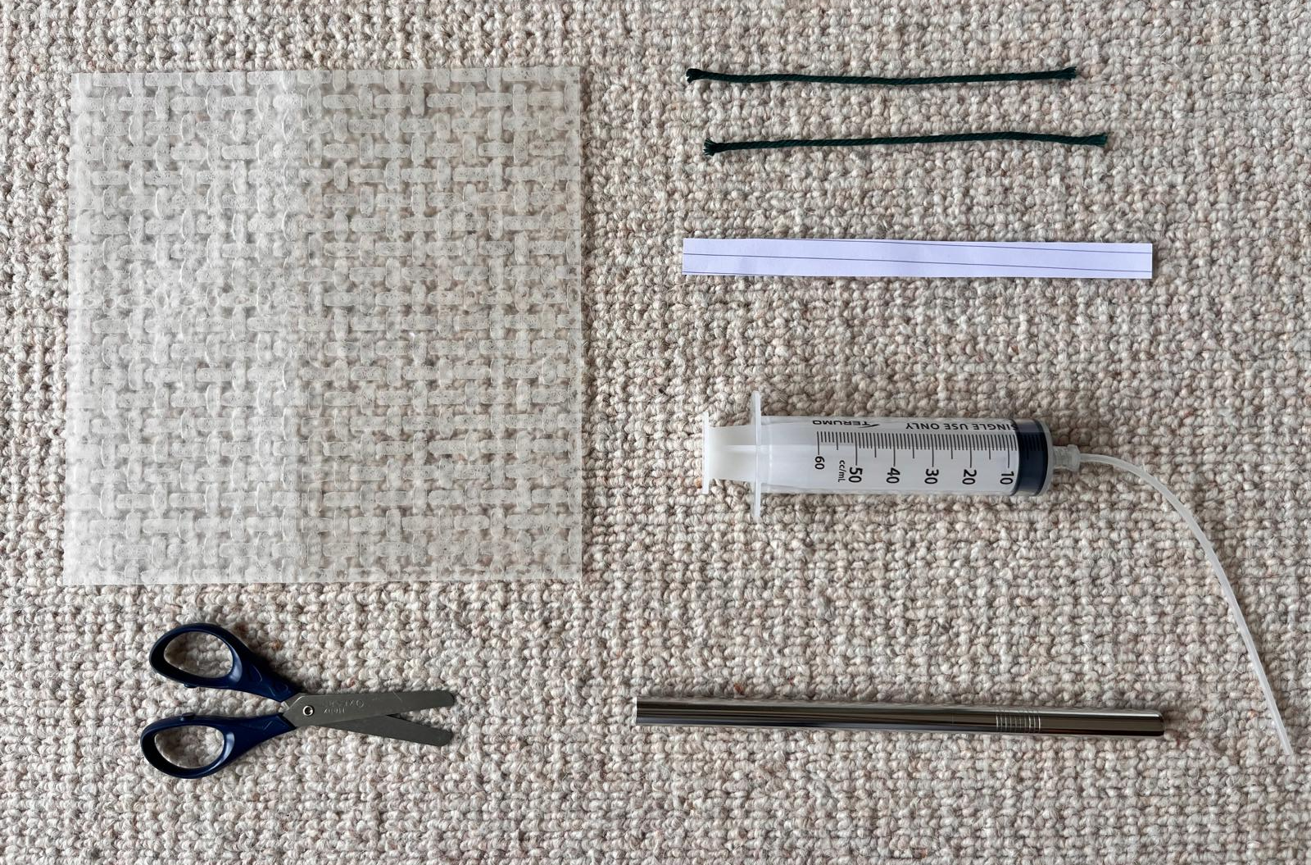
RICE PAPER SOFT ROBOTICS WORKSHOP
COLLECT YOUR MATERIALS
2 PIECES OF STRING
SHEET OF RICE PAPER
STRIP OF PAPER OR RICE NOODLE
SYRINGE WITH TUBE CONNECTED
SCISSORS
A METAL STRAW

Slide 12
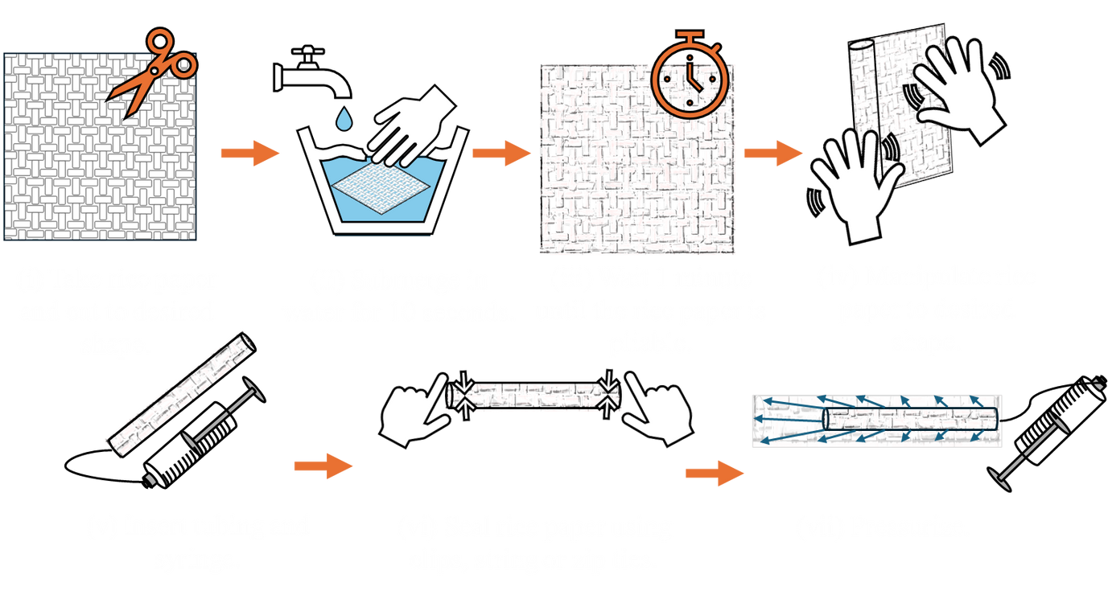
RICE PAPER SOFT ROBOTICS WORKSHOP
FABRICATION

Slide 13
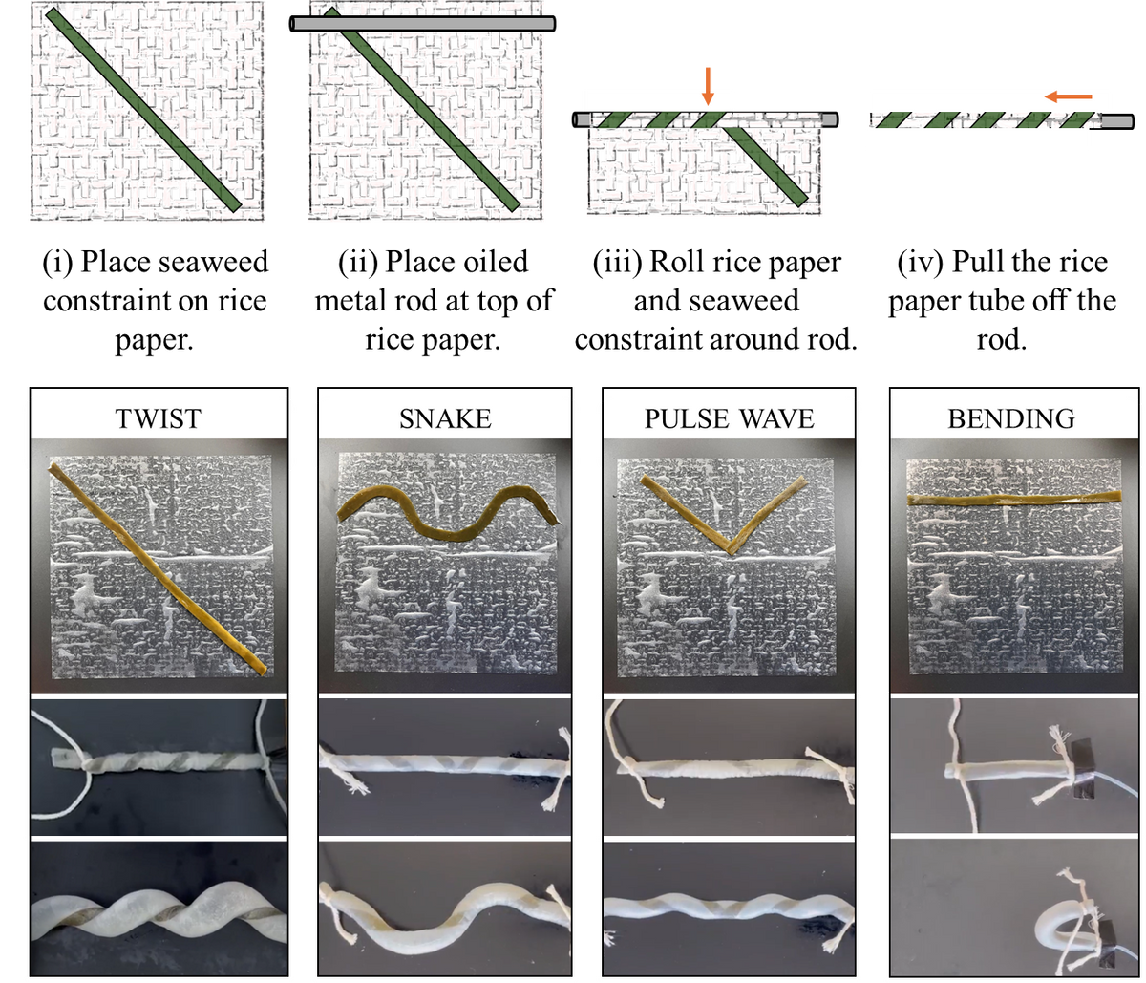
RICE PAPER SOFT ROBOTICS WORKSHOP
CHANGING SHAPES
Adding paper changes the movement!

Slide 14

RICE PAPER SOFT ROBOTICS WORKSHOP

Slide 15
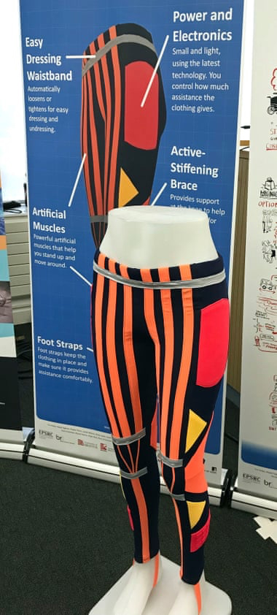
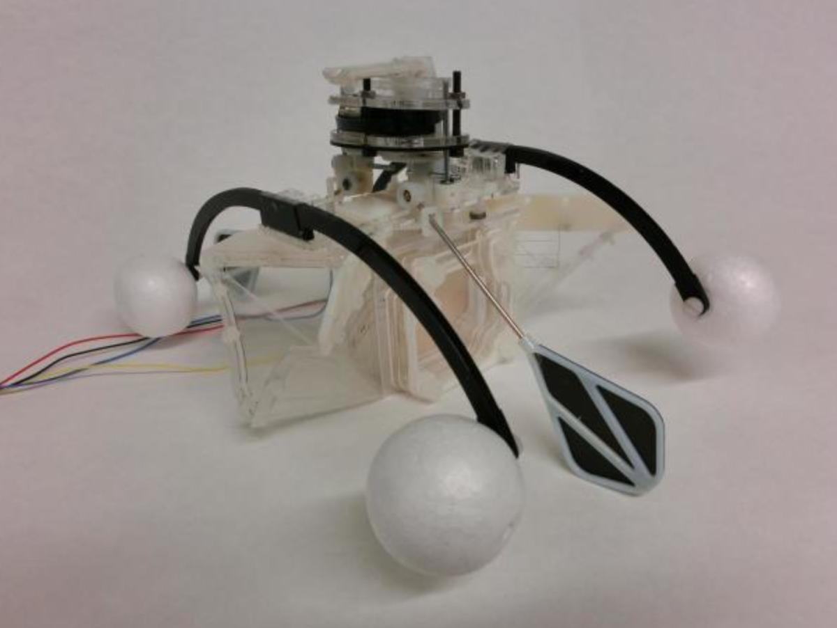
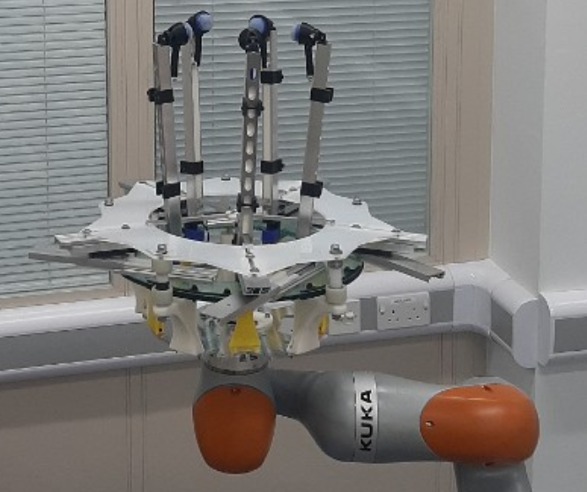
RICE PAPER SOFT ROBOTICS WORKSHOP
REAL-WORLD APPLICATIONS

Slide 16
RICE PAPER SOFT ROBOTICS WORKSHOP
IF YOU COULD DESIGN YOUR OWN SOFT ROBOT, WHAT WOULD IT DO?
DESIGN YOUR OWN!
DESIGN YOUR OWN SOFT ROBOT!

Slide 17


RICE PAPER SOFT ROBOTICS WORKSHOP
FABRICATION
(VIDEO FORM)

